Slide 1
Love Is…
LESSON PLANS

Slide 2
LOVE IS…LESSON PLANS
CHAPTER 1 – MONICA & CHELSEA
01
CHAPTER 2 – ELIZABETH & TYLER
02
CHAPTER 3 – SADIE & JOHN
03
Who can find a virtuous wife? She is worth more than precious rubies. Her husband can trust her, and she will greatly enrich his life.
Proverbs 31:10 - 11
Teach your children to choose the right path, and when they are older, they will remain on it Proverbs 22:6
But, if you forgive not men their trespasses, neither will your Father forgive your trespasses Matthew 6:15

Slide 3
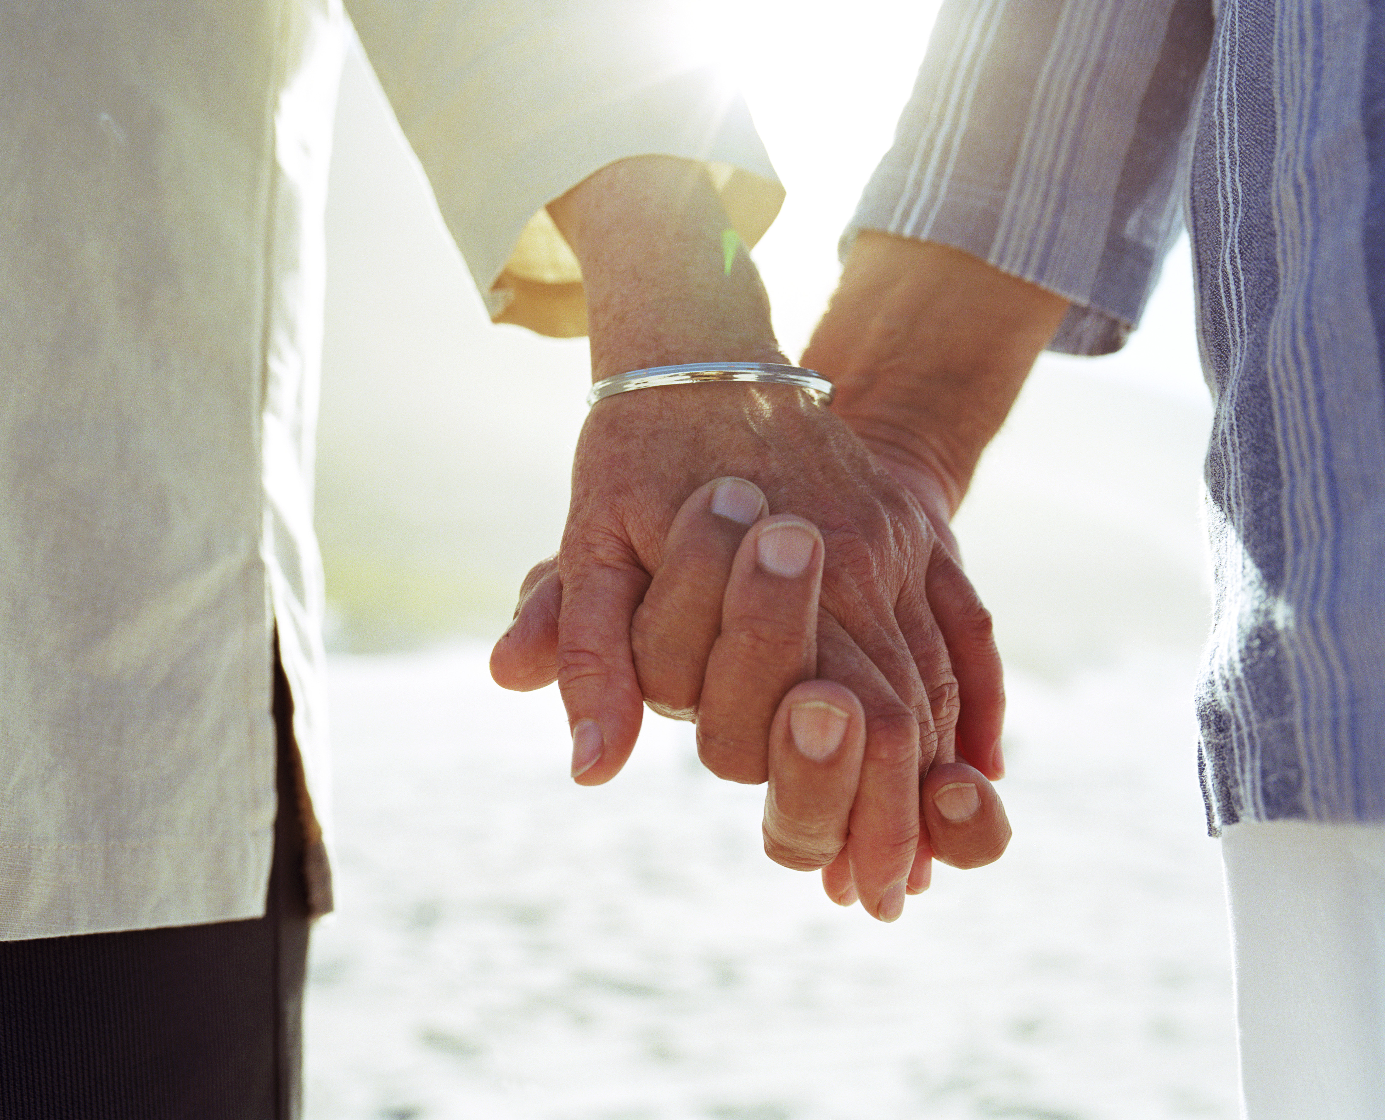
Introduction & ABBREVIATED LESSON PLANS (below)…
Let’s read God’s definition of love…
Read 1 Corinthians 13
Cite an example of someone or something that made you feel loved or something you’ve done to make someone else feel loved?
Do you believe most people feel loved in their relationships – why or why not?
What makes love so difficult in our relationships with others?
Name (1) way we can commit to demonstrating more love in our relationships with others – for me it would be actively listening as people are talking
Chapter 1 – Monica & Chelsea
Name words you would use to describe Monica’s personality…Chelsea’s personality?
How would you describe their friendship?
Do you believe Chelsea is right to believe Donovan will stop his other relationships to date her?
Do you believe teaching abstinence is still relevant in today’s society (i.e., please know this is not framed to ask you whether or not you remained abstinent…this is asking whether we believe teaching abstinence before marriage is still relevant today…
Name one lesson we can take away with us from this story – for me it would be to seek God in how to be a friend to each person (i.e., sometimes, we enter relationships w/preconceived notions of what friendship looks like for that person…all relationships are not the same)
Chapter 2 – Elizabeth & Tyler
Name words to describe Elizabeth & Tyler’s relationship?
Do you believe Tyler made the right decision to come clean w/Elizabeth or should he have “left it in the past” as Kevin was suggesting (i.e., ”what she doesn’t know won’t hurt her”)?
What do you think about Elizabeth’s initial response? Her eventual response?
Name one lesson we can take away with us from this story – for me, love is synonymous w/forgiveness, however, I recognize I may not always be quick to forgive others who hurt me in life. I must practice forgiveness daily.
Chapter 3 – Sadie & John
Name words to describe Sadie and John’s personalities
What do you think about their relationship?
What do you think about John’s initial decision to try and take care of Sadie at home? His eventual decision to take her to a nursing home?
Name one lesson we can take away with us from this story – someone once told me that love is a choice and I never forgot it…we make the choice daily whether to love others even when doing so may be difficult
Feedback on the Book or Book Club?

Slide 4
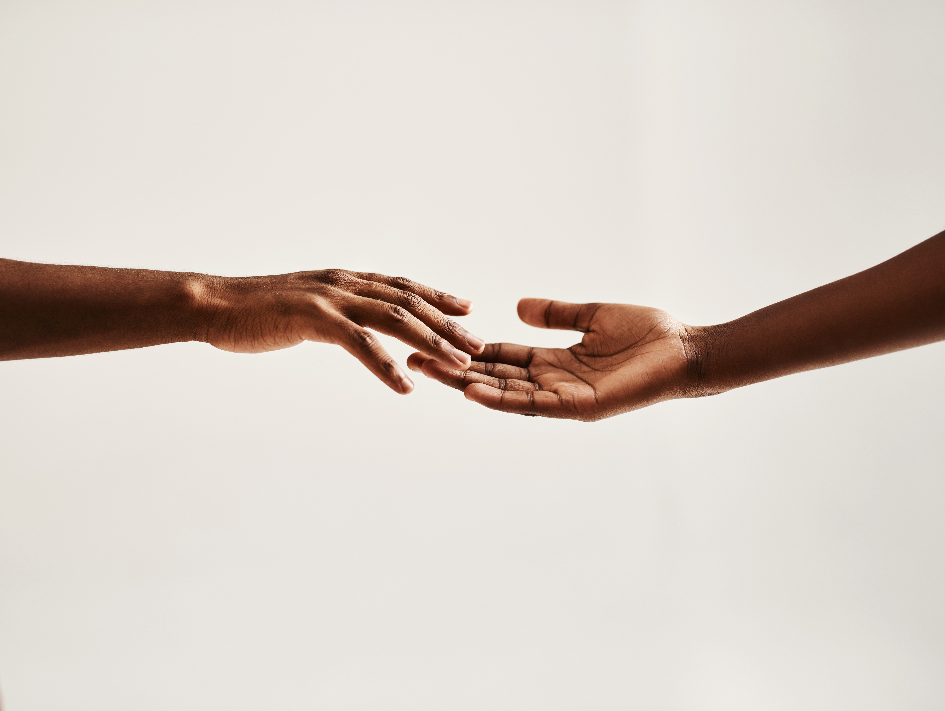
Monica & Chelsea Lesson Plan
Do the words below describe Monica’s personality? What examples can you give from the story that demonstrate these personality traits?
Kind, loyal, attractive yet slightly insecure
What do you think about Monica’s description of herself as “the exact opposite of Chelsea with a ‘dark brown complexion, jet black hair, pleasantly plump and what her father calls, ‘attractive?” Do you believe this description speaks to how she may feel about herself?
Do the words below describe Chelsea’s personality? What examples from the story demonstrate these personality traits?
Bold, confident, pretty, self-absorbed
Do you have a first impression of Monica and her relationship with her parents? What impact do you believe their “rules” and relationship with their daughter have on who she is today? Name (2) values or lessons Monica’s parents have passed down to her.
Describe Monica and Chelsea’s friendship.
Do you believe Chelsea is correct to believe that once Donovan starts dating her, he will break it off with his other girlfriends? Why or why not?
What is your first impression of Michael? What do you admire about him?
You will recall in the book that Monica and Chelsea made a recent commitment to abstinence when they were thirteen. Do you believe teaching abstinence is still relevant today (please note not asking whether you chose to be abstinent, but rather if teaching it…in today’s culture…is still relevant)?
Are there other parts of this story that stood out for you? If so, what are they?
What is (1) Lesson Learned you can come away with after reading this story?
Elizabeth & Tyler Lesson Plan
What words would you use to describe Elizabeth? Tyler?
Describe Elizabeth & Tyler’s relationship? Do you admire their relationship? Why or why not?
What words would you use to describe Kyla? Kevin?
Describe Kyla and Kevin’s relationship? Do you admire their relationship? Why or why not?
What do you think about Libby’s advice to Kyla that it typically takes 3 – 5 years to really get to know someone vs. getting engaged to someone after only 5 months of dating? Do you believe the amount of time a couple spends getting to know each other prior to marriage actually matters?
What criteria does it appear Kyla is using to convince herself that Kevin will make her a good husband? Do you agree or disagree? Why or why not?
What do you think about the circumstances that led to Tyler cheating (i.e., communicating on FB with someone he used to date, meeting her for lunch, accepting her phone number and not telling Libby about any of it initially)? Do you believe he made the right choice not to tell Libby about it / her?
What do you think about the advice Kevin gave Tyler after the offense? Do you agree w/him that it is best to “leave it in the past” and not tell Libby?
Describe Tyler’s apology to Elizabeth…was it humble? Did he “own” his mistake?
What is (1) Lesson Learned you can come away with after reading this story?

Slide 5
Sadie & John Lesson Plan
What words would you use to describe Sadie and John’s relationship?
We learned Sadie inherited her home from her grandfather, who was relatively poor, but he “determined in his heart to leave the house as an inheritance to his only granddaughter. ..he didn’t drive a fancy car, or go on expensive vacations,” but saved every penny to pay off the house so Sadie would own it. If you had any advice, you could go back 10 - 20 years and give your younger self, what would that advice be?
What do you think about John’s belief that his ex-fiancé, Irene, would make him “happy.” Do you believe many people marry today believing the other person will make them happy? What are your thoughts about that?
Sadie did not “run after” John. In fact, she made John appreciate the effort required to be in a relationship with her. In what ways did she do this?
What did John mean when he said, “I watched Sadie’s interactions from afar with others and not once did I hear anything that was contradictory to the life she led outside of the view of others…She was who she said she was.”
What do you think about Sadie’s decision to remain celibate until after she and John married?
Describe the first time Sadie met John’s parents and family. Describe their interactions.
Recalling the advice John’s mother gave Sadie –”Don’t take his love for granted Sadie. Respect, love and appreciate him…” How important do you believe respect, love and appreciation are in a marriage…any relationship?
Describe John’s response to Sadie as she developed dementia…
What is (1) Lesson Learned you can come away with after reading this story?
LOVE IS…LOVE DOES…LOVE WINS! SERIES

